Slide 1

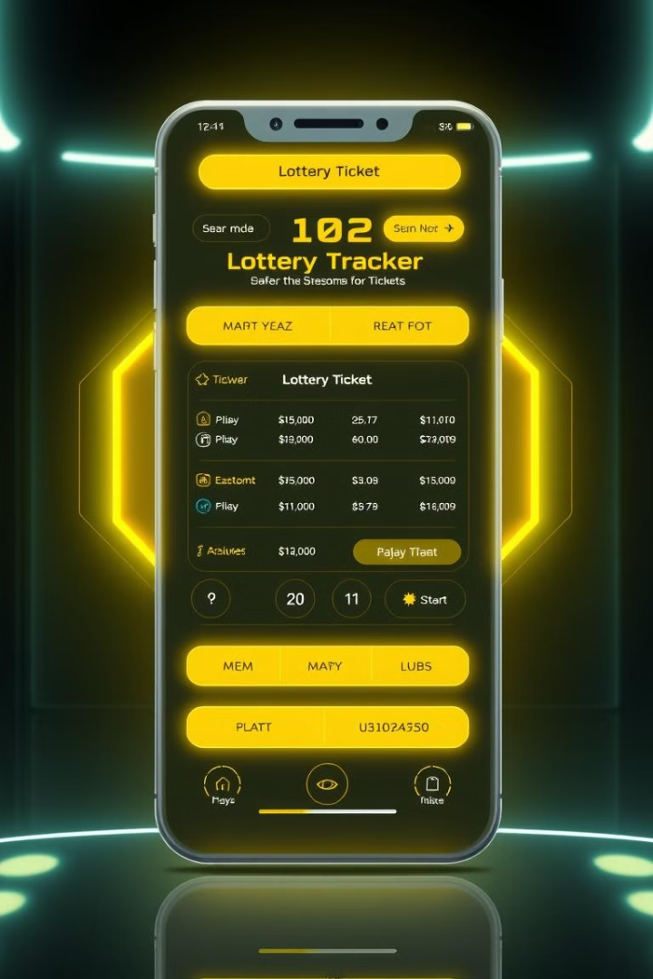
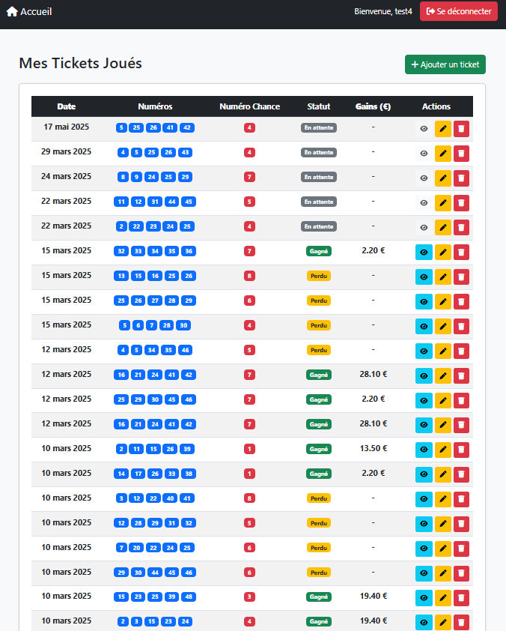
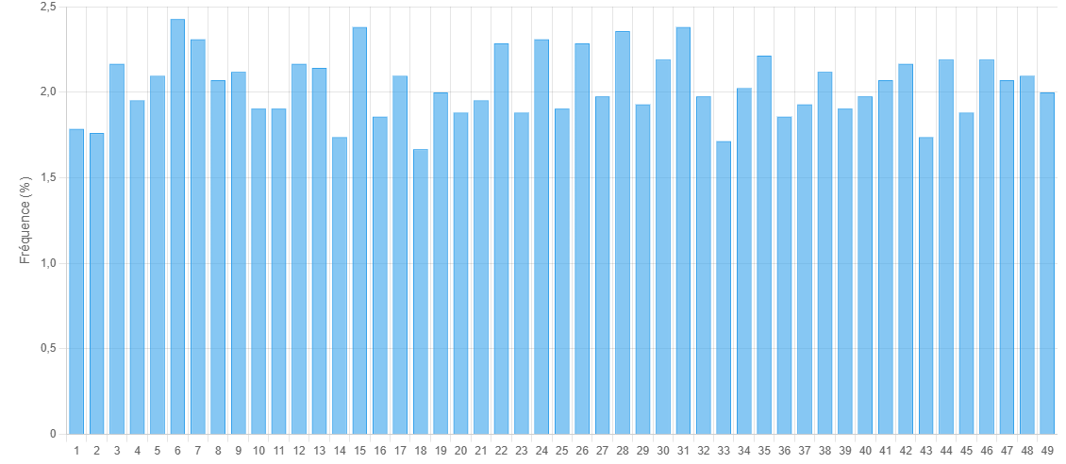
Loto Tracker API - Portfolio 2025
A presentation of the Loto Tracker API in Java Spring-Boot
Stéphane DINAHET
Holberton School RENNES
Notes:
Good [morning/afternoon] everyone! My name is Stéphane Dinahet, and I am excited to present my project, Loto Tracker API, developed as part of my portfolio at Holberton School Rennes.
This project is a lottery tracking API that provides a secure, automated, and real-time experience for users who want to check their lottery results efficiently.

Slide 2

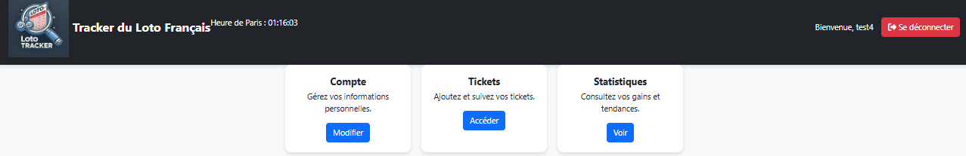


Project Overview
1
Secure Authentication
2
Ticket Management
JWT authentication for user management.
Submission and verification of lottery tickets.
3
Automated Comparison
4
Real-time Calculation
Automatic comparison with official FDJ results.
Real-time calculation of winnings.
Notes:
Checking lottery results manually can be time-consuming and prone to errors. Users need a more automated, accurate, and efficient way to compare their tickets with official results.
[Solution] Loto Tracker API offers:
Secure authentication with JWT for user management.
Ticket management for submission and verification.
Automated comparison with official FDJ results.
Real-time calculation of winnings.
This API ensures that users never miss a winning ticket and provides a seamless experience from ticket submission to results verification.

Slide 3
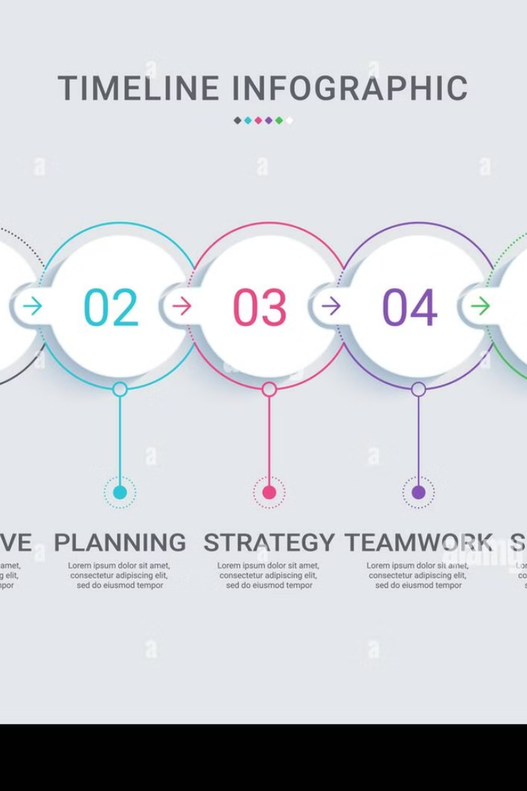




Development Process
1
Planning
Feature definition and technical research.
2
Backend Development
Implemented with Spring Boot
3
Database Integration
MongoDB & SQLite for storage.
4
Testing & Deployment
CI/CD pipeline with GitHub Actions & Docker.
Notes:
The development process followed four key phases:
Planning – Defined core features and conducted technical research.
Backend & Frontend Development – Implemented using Spring Boot.
Database Integration – Used MongoDB for history and SQLite for storing tickets and users.
Testing & Deployment – Set up a CI/CD pipeline with GitHub Actions and Docker.
This structured approach ensured a stable and efficient application.

Slide 4



Technical Architecture
Backend
Authentication
Storage
Automation
Package
Java 21
Spring Boot 3,4,2
Secure JWT (blacklist, short expiration).
SQLite for tickets & users, MongoDB for history.
Scraping official loto results every 30 minutes and calculation gains every 30 seconds.
Docker of Project
and integration testing with github actions
Notes:
Backend: Built with Java and Spring Boot to handle authentication, ticket management, and results processing.
Authentication: Uses JWT tokens stored in cookies for enhanced security.
Storage: SQLite for users and tickets. MongoDB for historical results.
Automation: Scrapes official Loto results every 30 minutes. Calculates winnings every 30 seconds to ensure real-time updates.
Packaging & Deployment: Dockerized for easy deployment, with integration testing through GitHub Actions.

Slide 5
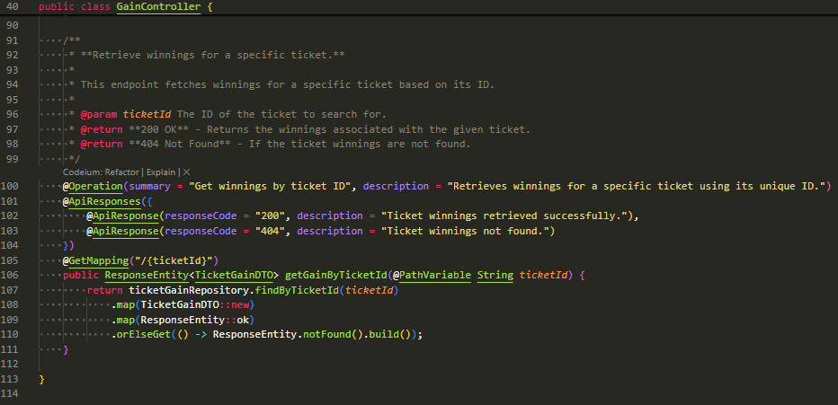
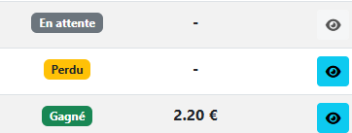
API Backend (Java Spring-Boot)
Notes:
Image 1: API for Retrieving Ticket Winnings
📌 Context: This screenshot shows an excerpt from the GainController in Java Spring Boot, responsible for retrieving lottery ticket winnings based on their ID.
🔹 Key Points to Explain in the Presentation:
The @GetMapping("/{ticketId}") annotation allows retrieving a ticket's winnings via a GET request using its ID as a parameter.
Spring Doc OpenAPI (@Operation and @ApiResponses) is used to document the API efficiently.
The response is a DTO (TicketGainDTO), ensuring a clear separation between the database layer and the exposed API.
The result is returned as a ResponseEntity, handling both successful (200 OK) and not found (404 Not Found) cases.
📌 Bonus Visual: The bottom part of the image displays the user interface, where users can see if their ticket is won ("Gagné"), lost ("Perdu"), or pending ("En attente").
Image 1 : API de récupération des gains d’un ticket
📌 Contexte : Cette capture montre un extrait du contrôleur GainController en Java Spring Boot, qui permet de récupérer les gains associés à un ticket de loterie via son ID.
🔹 Points clés à expliquer dans la présentation :
L'annotation @GetMapping("/{ticketId}") permet de récupérer les gains d’un ticket via une requête GET en passant l’ID du ticket en paramètre.
L’utilisation de Spring Doc OpenAPI (@Operation et @ApiResponses) facilite la documentation de l’API.
La réponse est un DTO (TicketGainDTO), ce qui assure une séparation claire entre la base de données et l’API exposée.
Le résultat est renvoyé sous la forme d’un ResponseEntity, qui gère les cas où un ticket est trouvé (200 OK) ou non (404 Not Found).
📌 Bonus visuel : La partie en bas de l’image affiche l’interface utilisateur où l’utilisateur voit s’il a gagné, perdu, ou si son ticket est en attente d’un tirage.

Slide 6
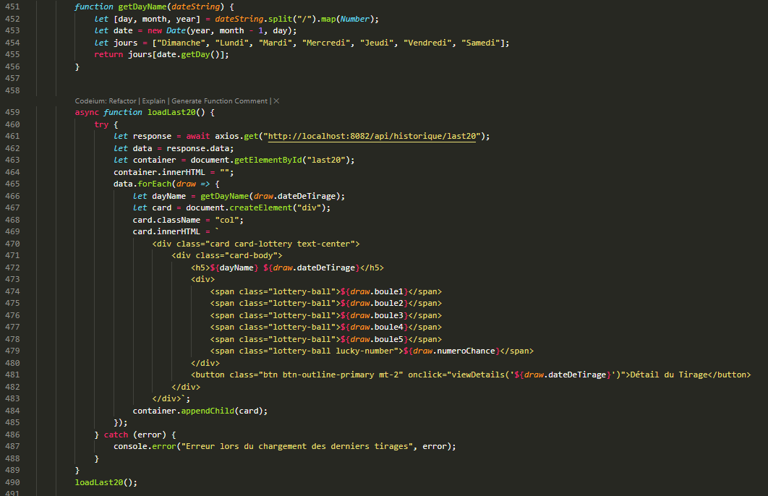
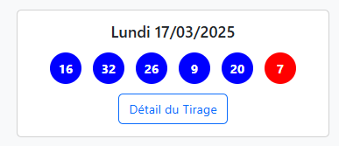
API Frontend (JavaScripte)
Notes:
Image 2: Displaying the Latest Loto Draws
📌 Context: This screenshot illustrates the frontend implementation in JavaScript (using Axios and HTML/CSS), displaying the latest lottery results.
🔹 Key Points to Explain in the Presentation:
The JavaScript code uses Axios to fetch the last 20 draws via a GET request (http://localhost:8082/api/historique/last20).
The function getByDayName(dateString) determines the day of the week corresponding to a given draw date.
The forEach loop iterates through the API response and dynamically generates cards (div elements) containing:
The day of the draw.
The winning numbers, displayed as blue and red lottery balls.
A "Détail du tirage" ("Draw Details") button, which provides more information about a specific draw.
📌 Bonus Visual: The right side of the image shows the rendered user interface, featuring a clean and structured design for an intuitive experience.
Image 2 : Affichage des derniers tirages du Loto
📌 Contexte : Cette capture illustre la partie frontend en JavaScript (avec Axios et HTML/CSS), qui affiche les derniers résultats du loto.
🔹 Points clés à expliquer dans la présentation :
Le code JavaScript utilise Axios pour récupérer les 20 derniers tirages via une requête GET (http://localhost:8082/api/historique/last20).
La fonction getByDayName(dateString) permet de récupérer le jour de la semaine correspondant à une date donnée.
La boucle forEach parcourt les résultats renvoyés par l’API et génère dynamiquement des cartes (card) contenant :
Le jour du tirage.
Les numéros gagnants sous forme de boules bleues et rouges.
Un bouton "Détail du tirage", qui permet d’afficher plus d’informations sur un tirage spécifique.
📌 Bonus visuel : La partie droite de l’image montre le résultat visuel affiché à l’utilisateur, avec un style épuré et clair.

Slide 7
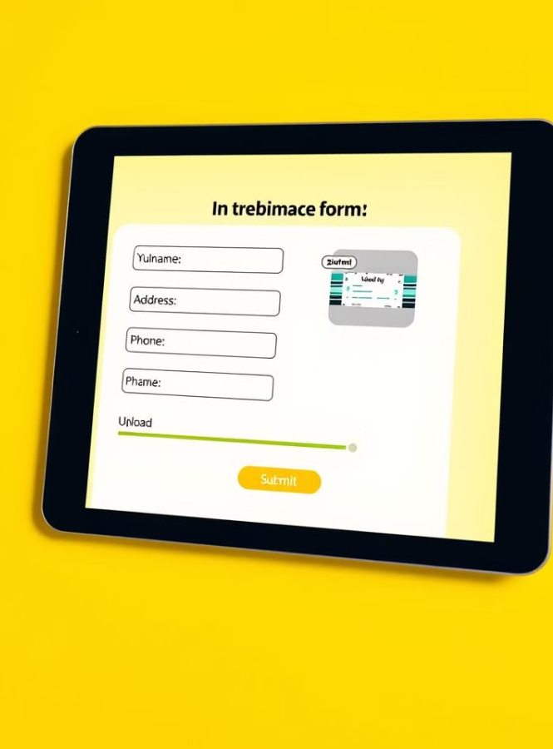
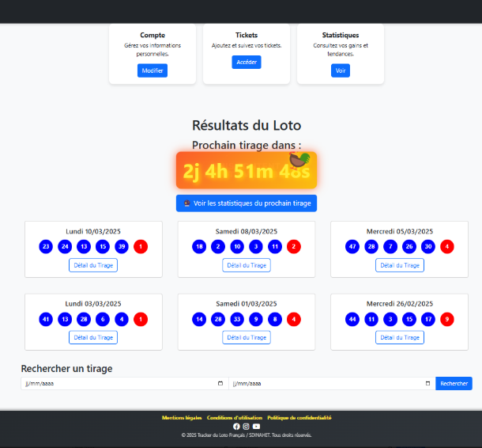
MVP Demonstration
User Registration
Show user registration and authentication.
Ticket Submission
Submitting and verifying lottery tickets.
Real-time Winnings
Real-time winnings calculation.
API Interaction
API & database interactions.
Notes:
Now, let’s take a look at the core functionalities of the Loto Tracker API:
User Registration & Authentication – Secure sign-up and login process with JWT.
Ticket Submission – Users can submit their lottery numbers via API.
Real-time Winnings Calculation – Automatic verification against official results.
API Interaction – Demonstrates interaction between the frontend, database, and backend.
By automating these processes, we eliminate manual errors and provide a seamless experience for users.

Slide 8
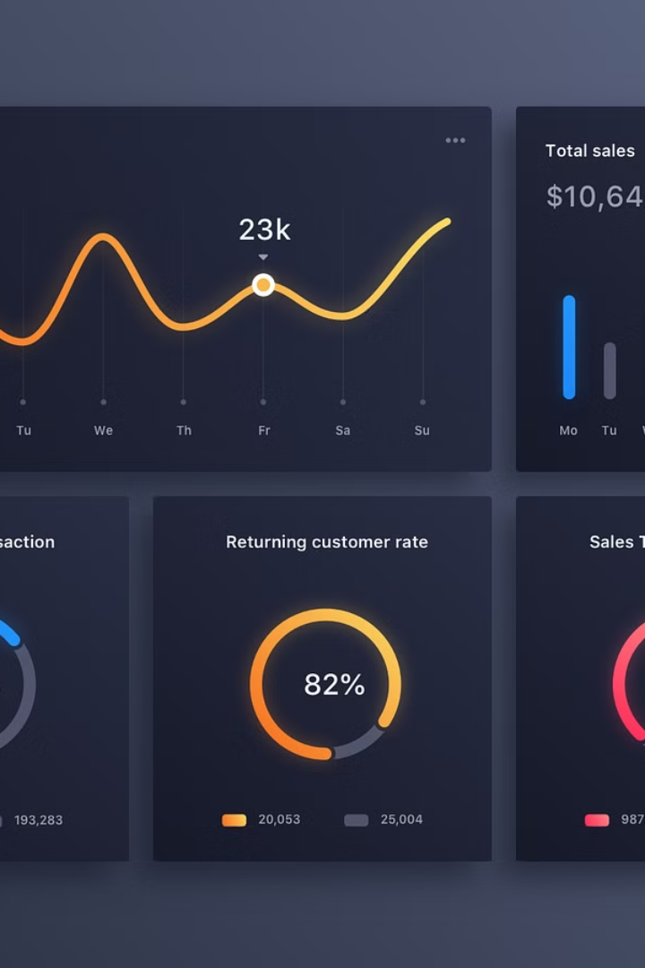
Performance & Results
200ms
Average API Response
Average API response time.
98%
Request Success
API request success rate.
250+
Tickets Analyzed
Total tickets analyzed.
10
Critical Bugs
Critical bugs resolved.
Notes:
The API has achieved strong performance metrics:
200ms average response time.
98% request success rate.
250+ tickets analyzed during testing.
10 critical bugs identified and resolved during development.
These results demonstrate the reliability, efficiency, and scalability of the system.

Slide 9



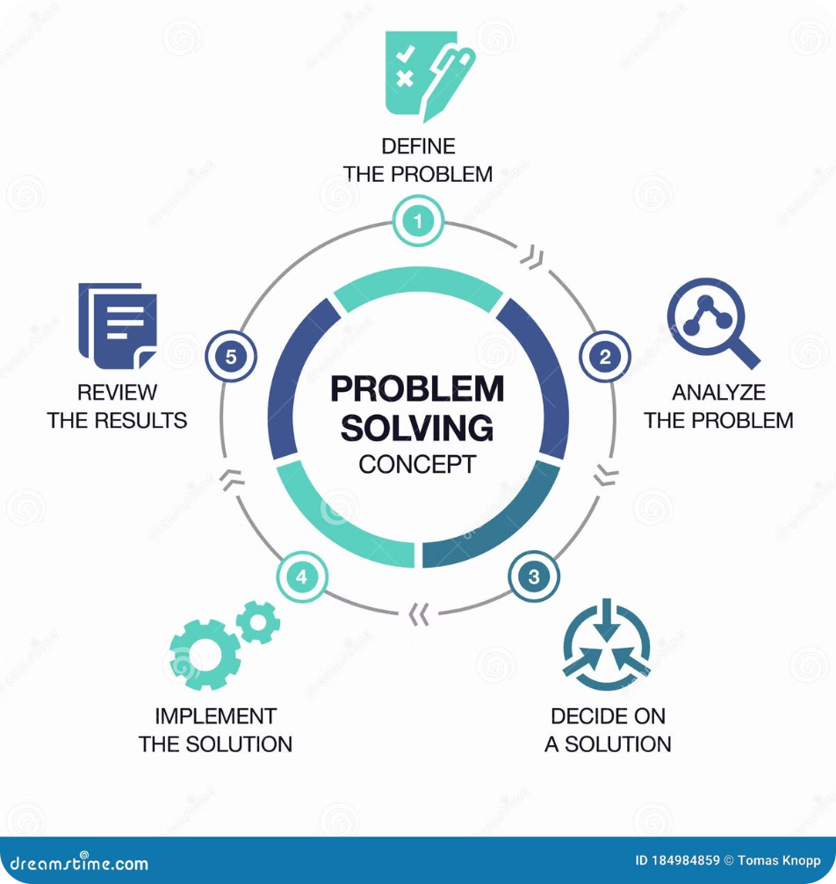



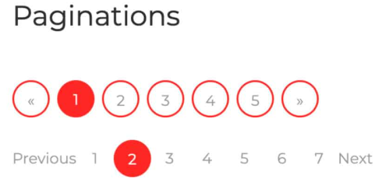


Key Challenges & Solutions
JWT Issues
Implemented token in cookies.
Database Scaling in future
Migration SQLite to PostgreSQL.
Slow Comparison
Optimized queries
Security Issues
Configured Spring Security
Notes:
JWT Issues – Initially had security vulnerabilities, solved by implementing secure token storage in cookies.
Database Scaling – Anticipating growth, planned migration from SQLite to PostgreSQL.
Slow Comparison Process – Optimized queries to speed up ticket validation.
Security Concerns – Configured Spring Security to enhance protection.
Each challenge provided valuable learning opportunities that improved the final product.

Slide 10



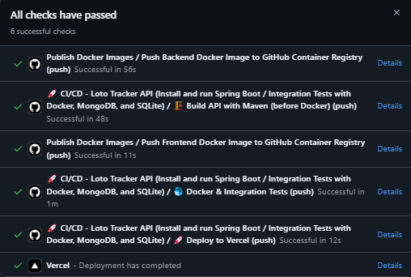


Lessons Learned
Efficient database management is crucial.
Secure authentication requires proactive measures.
Early user testing improves quality.
CI/CD automation saves time.
Notes:
Throughout the development of Loto Tracker API, I learned:
Efficient database management is crucial – Choosing the right database impacts performance.
Secure authentication requires proactive measures – Using JWT and Spring Security improved security.
CI/CD automation saves time – Automating tests and deployment streamlined development.
Early user testing improves quality – Identifying bugs early led to a more stable release.
These insights will shape future projects and improve my overall development process.

Slide 11




Conclusion & Next Steps
Thank You!
2
Stable API
1
Project Success of MVP
3
SDINAHET/Loto_API
MVP developed & tested successfully with Github actions. Next steps: Deployment on a stable hosting platform.
Project Repository: GitHub Repository CI/CD Actions Landing Page
Notes:
Loto Tracker API is now stable and fully functional. The next step is deploying it on a stable hosting platform to make it accessible for users. Further enhancements will include scaling the database and improving user experience.
That concludes my presentation. Thank you for your attention!
If you have any questions, I’d be happy to answer them now. You can also explore the project repository here: 📌 GitHub Repository: github.com/SDINAHET/Loto_API

